Slide 1


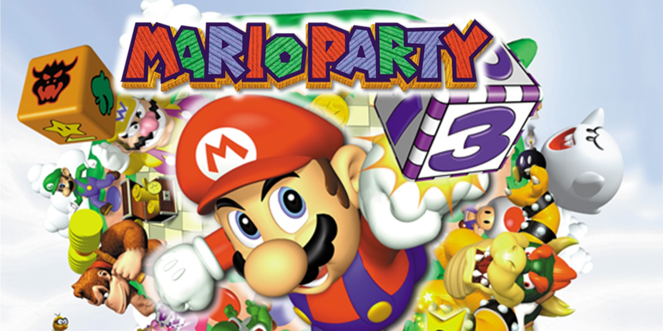
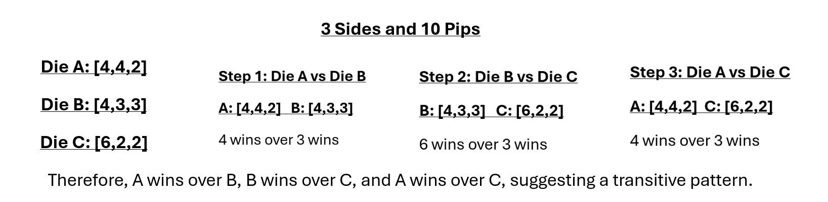
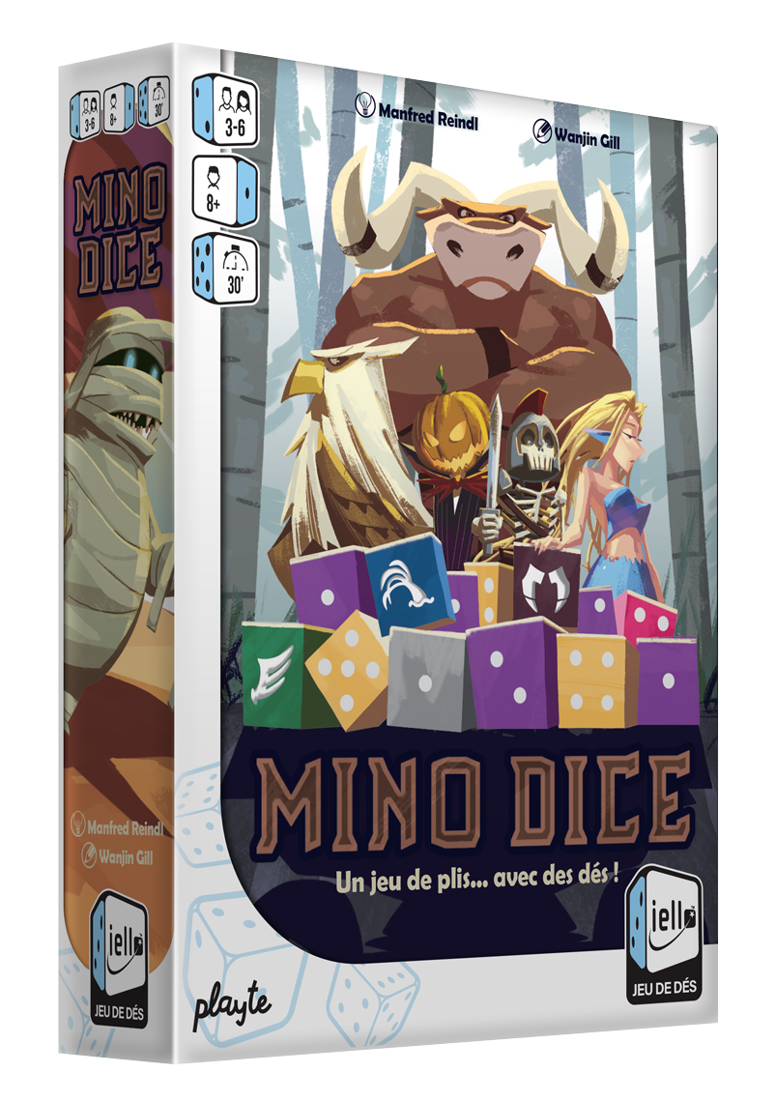
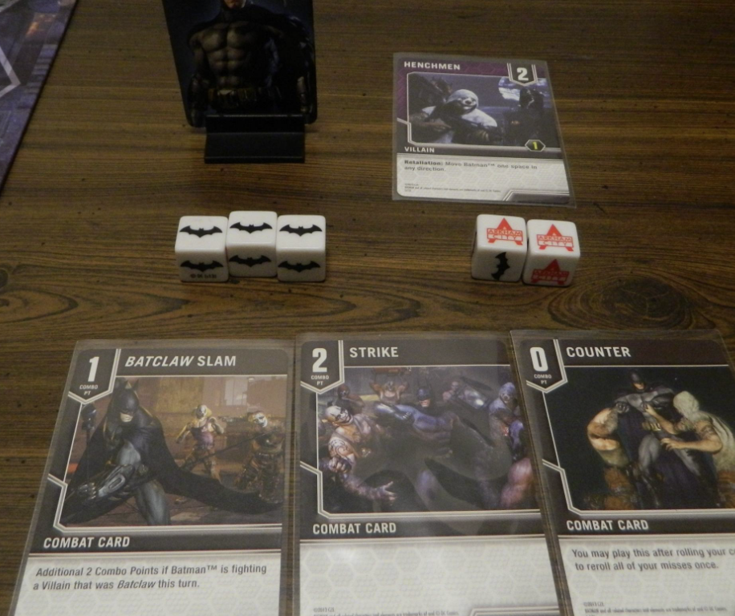
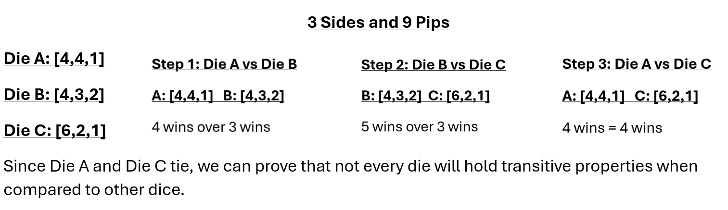
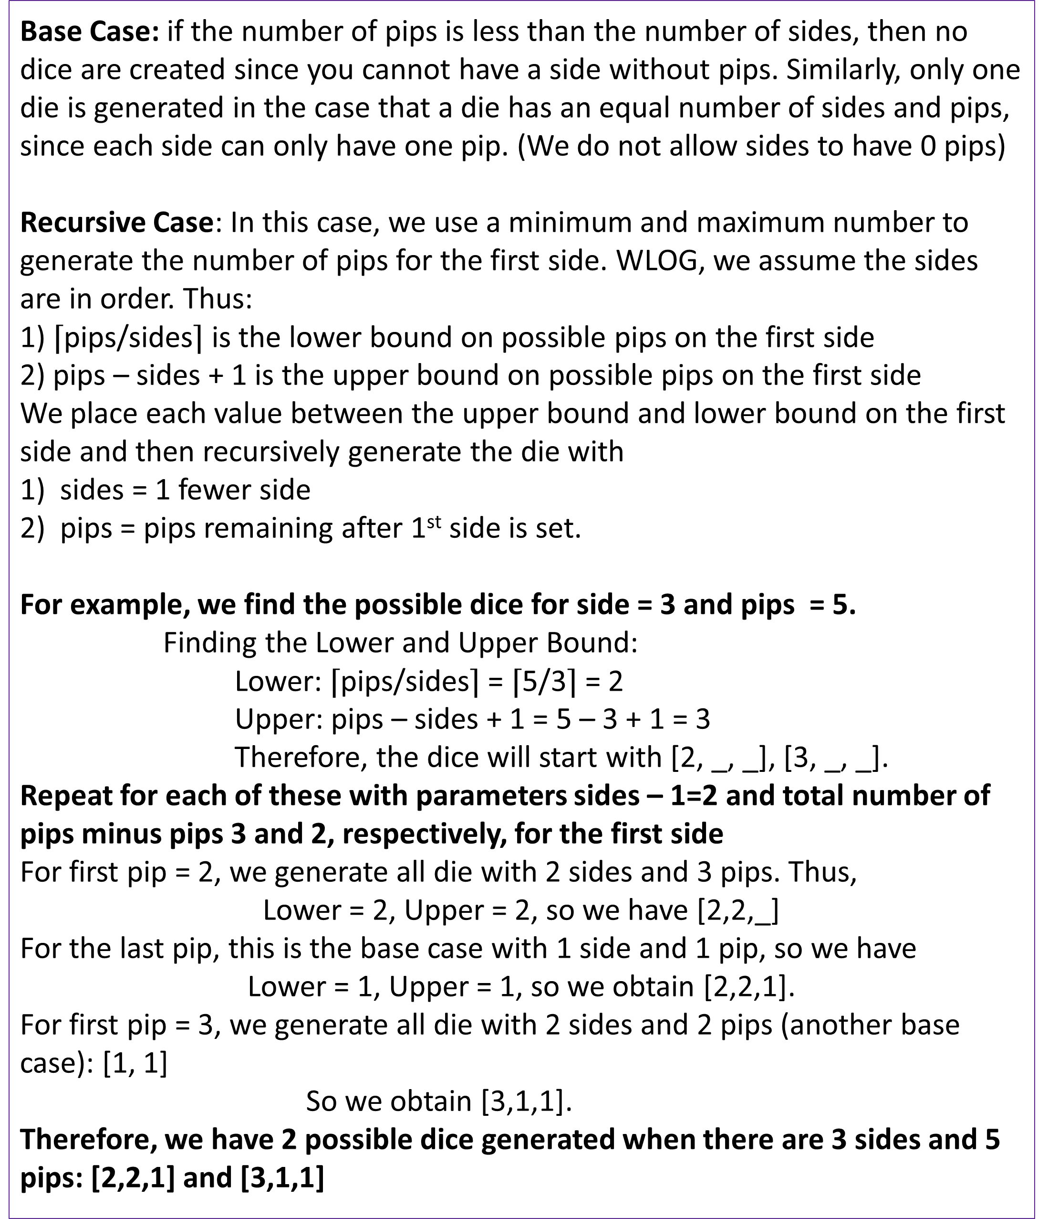
Analysis of Optimal Die Configurations
Mary Kait Heeren, Dr. Jeremy Becnel
Department of Computer Science, Stephen F. Austin State University
Abstract
More Dice Comparisons
Counting Dice Recursively
This exploration aims to analyze the mathematical intricacies of constructing dice with a specified number of sides and pips, focusing on combinatorial analysis. The initial motivation stemmed from developing a Python program to generate and compare dice configurations. This program is a practical tool for visualizing die combinations, leading to a deeper investigation into related mathematical concepts.
The investigation uses an algorithm to construct all possible dice and compares them to determine the optimal configuration, which is the configuration with the highest probability of winning on a given roll when comparing sides. Additionally, we explore the relationship between the die, including the concept of transitivity in the dice “wins” relationship.
Definition. Given two dice A and B with the same number of sides, a die A is said to win over another die B if given every pairing of sides (a,b) where a is from A and b is from B, the majority of the pairing satisfy a > b.
Given 3 sides and 6 pips to divide over the sides. We can generate the possible die:
[4,1,1],[3,2,1],[2,2,2]
Therefore, when compared…
[4,1,1] & [3,2,1]: [3,2,1] wins
[4,1,1] & [2,2,2]: [2,2,2] wins
[2,2,2] & [3,2,1]: TIE
Therefore, this example demonstrates that there is not always a “best” die given a specified number of sides and pips. Here both [3,2,1] and [2,2,2] perform equally well.
Base Case: if the number of pips is less than the number of sides, then no dice are created since you cannot have a side without pips. Similarly, only one die is generated in the case that a die has an equal number of sides and pips, since each side can only have one pip. (We do not allow sides to have 0 pips)
Recursive Case: In this case, we use a minimum and maximum number to generate the number of pips for the first side. WLOG, we assume the sides are in order. Thus:
1) $⌈$pips/sides$⌉$ is the lower bound on possible pips on the first side
2) pips – sides + 1 is the upper bound on possible pips on the first side
We place each value between the upper bound and lower bound on the first side and then recursively generate the die with
sides = 1 fewer side
pips = pips remaining after 1st side is set.
For example, we find the possible dice for side = 3 and pips = 5.
Finding the Lower and Upper Bound:
Lower: $⌈$pips/sides$⌉$= $⌈$5/3$⌉$= 2
Upper: pips – sides + 1 = 5 – 3 + 1 = 3
Therefore, the dice will start with [2, _, _], [3, _, _].
Repeat for each of these with parameters sides – 1=2 and total number of pips minus pips 3 and 2, respectively, for the first side
For first pip = 2, we generate all die with 2 sides and 3 pips. Thus,
Lower = 2, Upper = 2, so we have [2,2,_]
For the last pip, this is the base case with 1 side and 1 pip, so we have
Lower = 1, Upper = 1, so we obtain [2,2,1].
For first pip = 3, we generate all die with 2 sides and 2 pips (another base case): [1, 1]
So we obtain [3,1,1].
Therefore, we have 2 possible dice generated when there are 3 sides and 5 pips: [2,2,1] and [3,1,1]
Games with Asymmetrical Die
Mino Dice: The dice decide who wins each round. Number dice roll numbers, and special dice (like Minotaur's and Griffins) beat the number dice based on a simple rock-paper-scissors-like system.
Mario Party: The dice mechanics combined with skill-based mini-games make Mario Party a blend of luck, strategy, and competition.
Batman: Arkham Chronicles: The game features dice-based mechanics where each roll can influence actions like combat, movement, or special abilities. Typically, the dice represent critical elements such as attacks, dodges, or actions that affect the outcome of battles against villains or completing mission objectives.
Transitivity Failure
A relation is transitive whenever one element is related to a second element, and that second element is related to a third element, then the first element is also related to the third element.
In terms of dice:
If Die A wins over Die B, and Die B wins over Die C, then for transitivity to hold, Die A should also win over Die C.
.
Therefore, transitivity is not consistent in dice comparison, disproving the theory that dice could hold transitive properties in every case.
Conclusion
Through the development of Python programming for generating and comparing dice configurations, we observed transitivity does not universally hold amongst dice comparisons. We explored variations of comparison including “overall strength” versus “face-to-face” comparison and how outcomes will vary between both in regard to transitivity. We utilized recursion to explore and quantify the number of possible dice configurations.
Overall, this research highlights the complexity of dice analysis that range from applications in programming to combinatorics. These results suggest an unconventional nature of dice and open the door for further investigation into the behavior of dice and their application in different environments.
Contact
Acknowledgements
References
Mary Kait Heeren
Department of Computer Science
P.O. Box 9837, SFA Station Nacogdoches, Texas 75962
heerenmk@jacks.sfasu.edu
The College of Sciences and Mathematics supported this research as part of the Undergraduate Research Experience at Stephen F. Austin State University. I’d like to thank Stephen F. Austin State University and Jeremy Becnel for providing an opportunity to get involved in a Research Experience, as it has been an insightful and rewarding process.
Thank you to the Computer Science department for the workspace and the equipment used throughout the entirety of the project.
A special thanks to Dr. Nicolas Long for introducing the concept of dice combinatorics that this project is based on.
1. Jupyter Notebook (Project Jupyter | Home)
2. Geeks for Geeks (Transitive Relations: Definition, Properties, and Examples (geeksforgeeks.org))
3. Github Repository (SFA-CS/DiceProblem)

